Slide 1
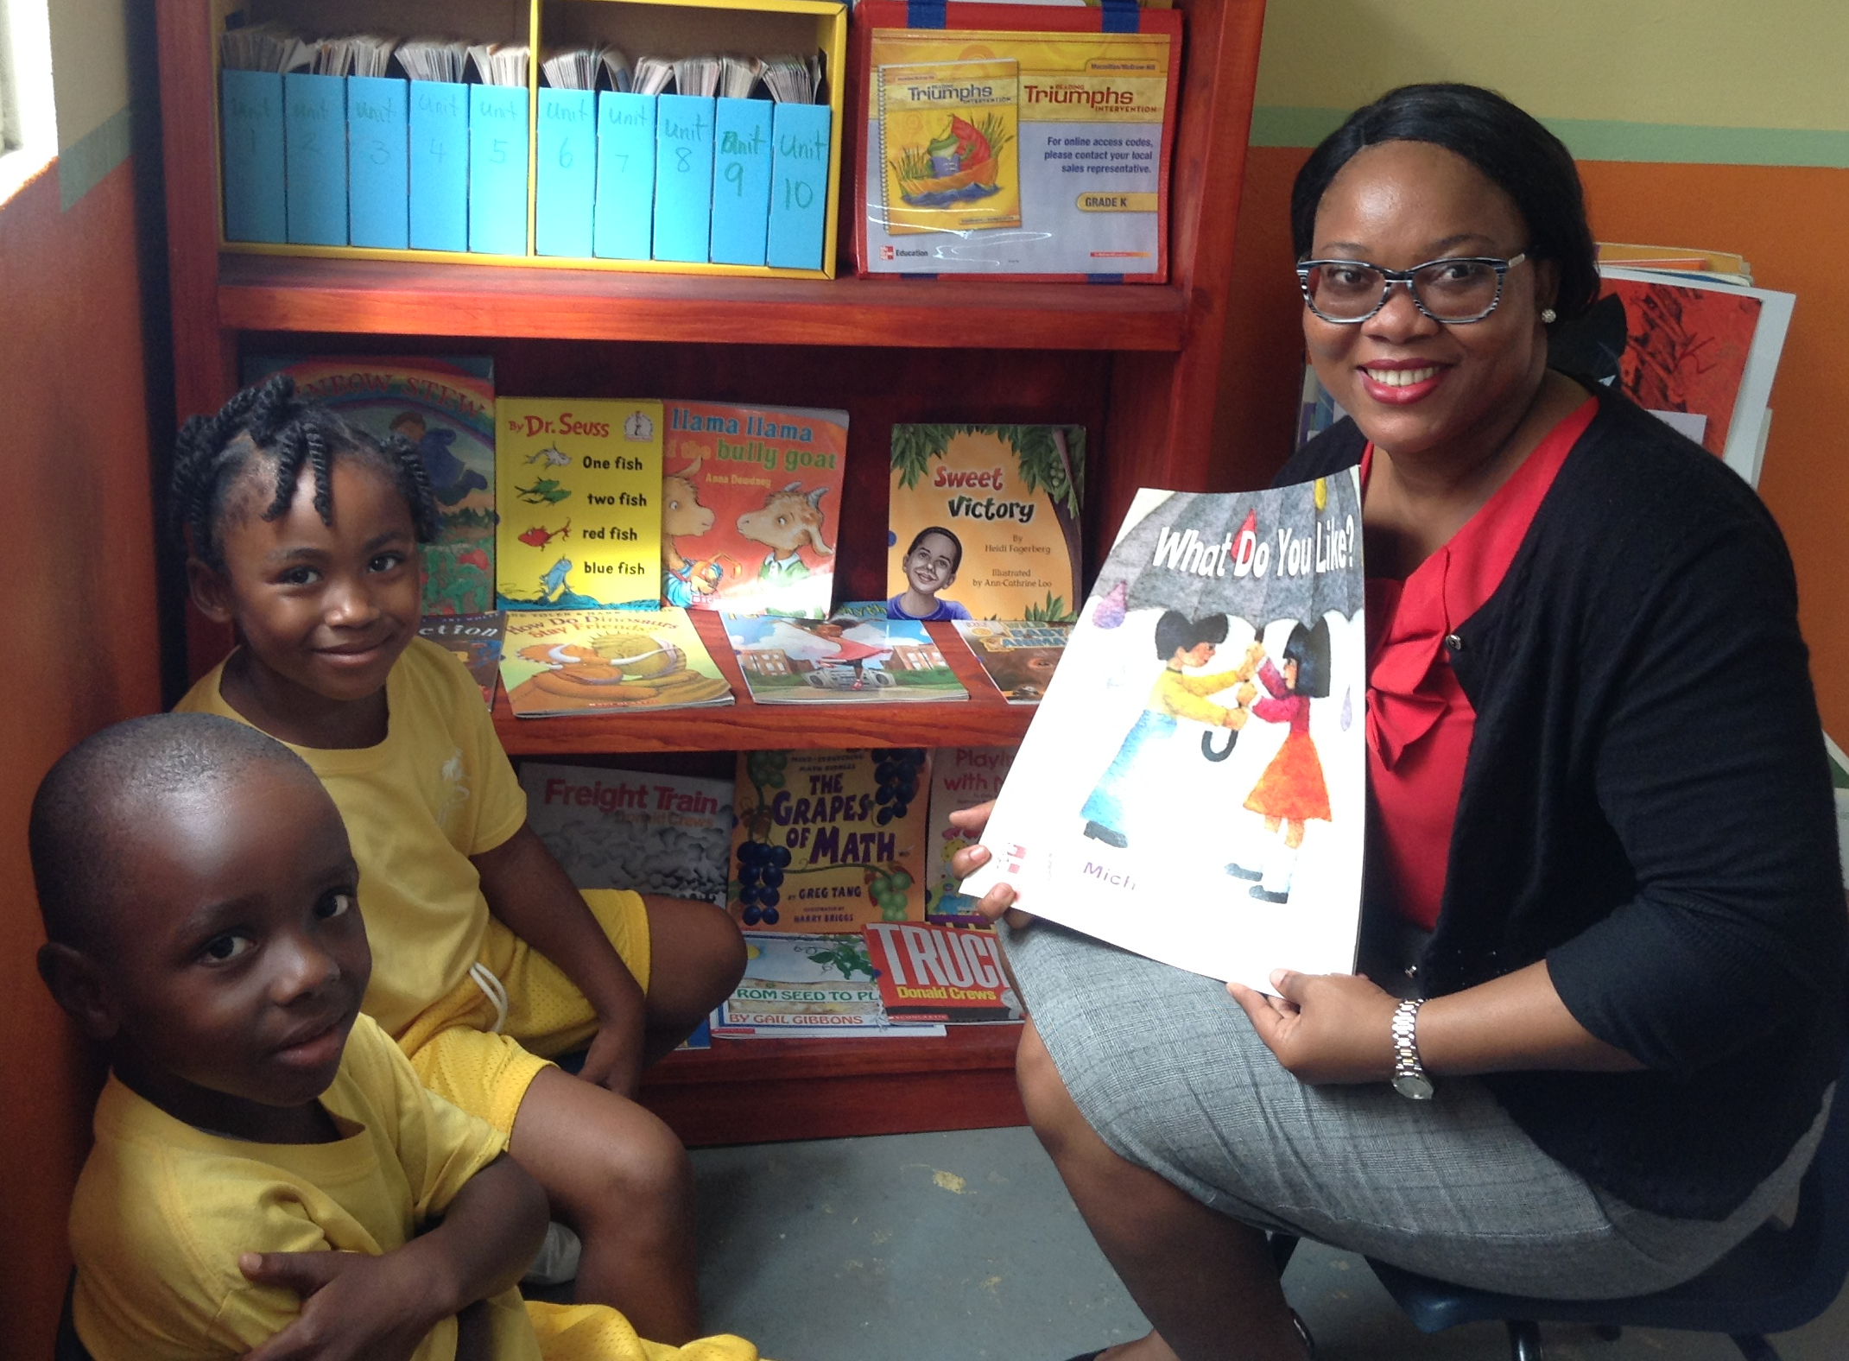
The Art and Craft of
Reading Aloud
Teachers Resource Guide to the Library
Notes:
In this video, we will be discussing the *art and craft of reading aloud to your students and how to use books to teach your curriculum content. *We will review how to use a book as an anchor text for lessons, read aloud and shared reading best practices.

Slide 2
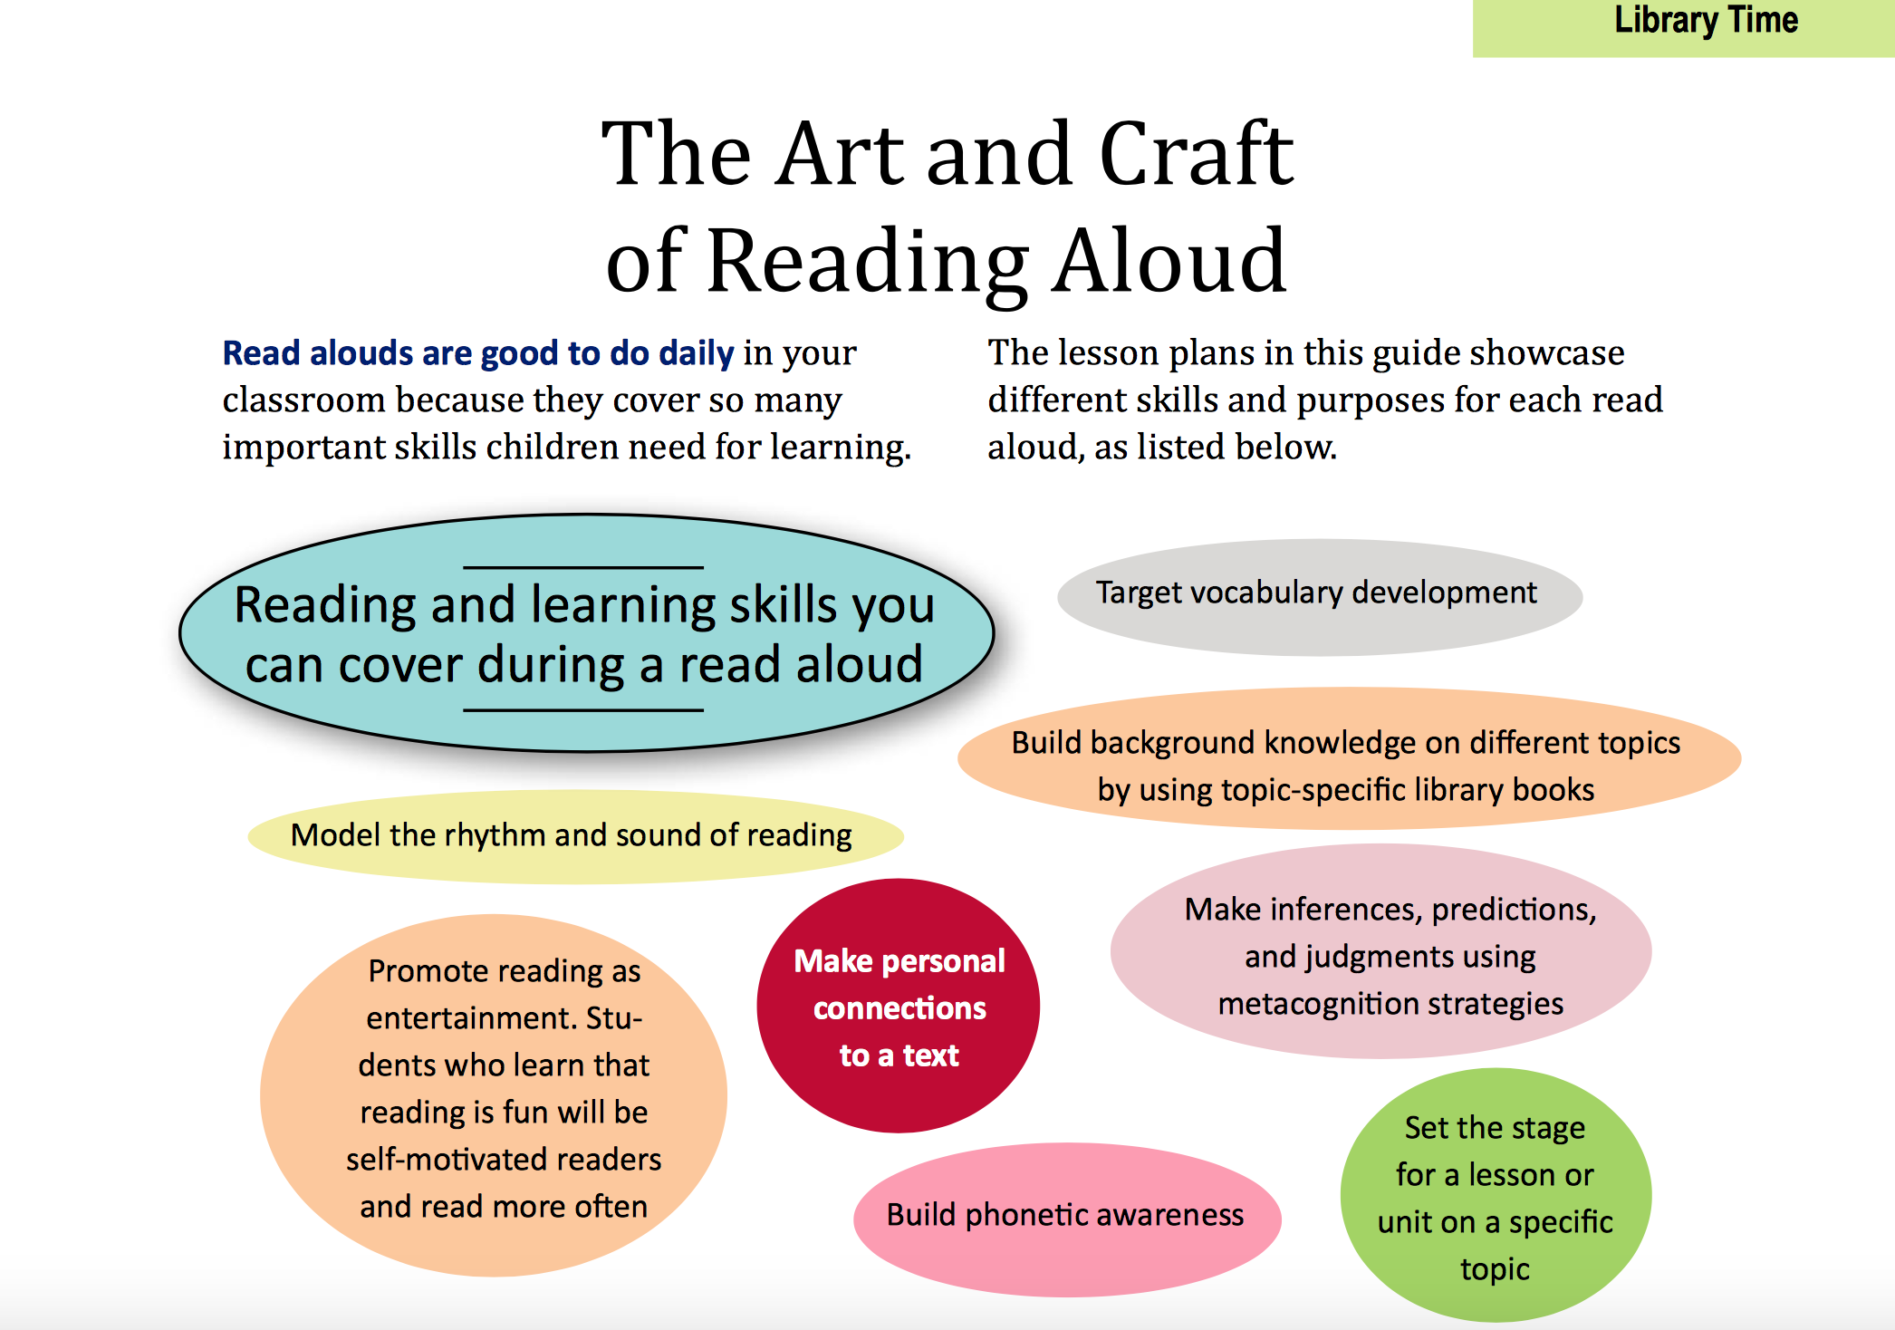
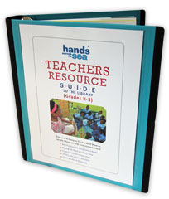
Notes:
The Art and Craft of Reading aloud is highlighted in the Library Time section of the *Teachers Resource Guide produced by Hands Across the Sea. Read alouds are good to do daily in your classroom because they cover so many important skills that children need for learning. Discuss with someone sitting next to you some of the reasons given on this slide about why read alouds are so important to include when teaching. Pause the video now to give teachers a minute or two to discuss.

Slide 3
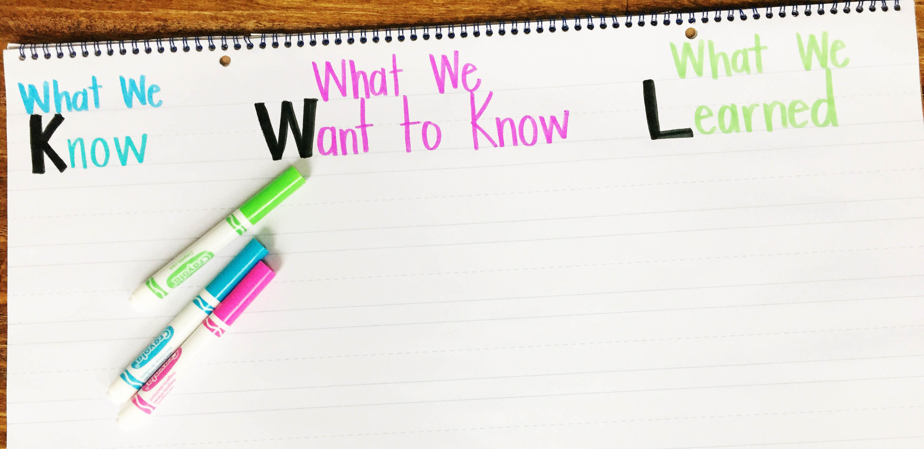
Anchor Texts and Interactive Read Alouds
1.
2.
3.
4.
1.
2.
3.
4.
Notes:
Facilitators can fill out a K-W-L chart about *what you already know about anchor texts and interactive read alouds. *What do you hope to learn about these concepts? *We need at least 4 responses for *each question. Pause the video and resume once you have filled out the first two columns of the chart.

Slide 4
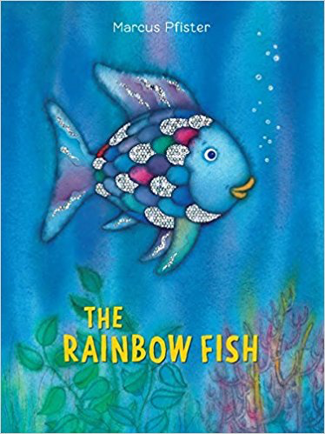

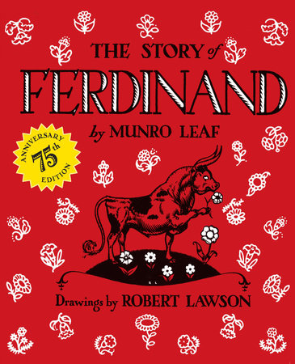
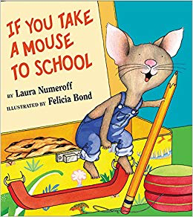

Anchor Texts
Books that can be referred to often and are used as models to teach reading skills and strategies.
Notes:
Read alouds can often be used as anchor texts that you can build your Language Arts lesson on. Anchor texts are books that can be referred to often and are used as models to teach reading skills and strategies.

Slide 5
Anchor Texts
Step 1: Scan your curriculum. What are some key concepts you will need to teach this term?
Step 2: Make a list of how it can be used to teach.
Step 3: Read through a favorite book and sticky-note where this book mentions, models, or refers to content.
How can I use this book to teach my curriculum content?
Notes:
First, we have to be familiar with the books in our school’s library to know what books are available to use with our lessons.
So if you haven’t gone to your school’s library, go! Pick out 5 books that look appealing, read them to yourself or to your own children at home and start thinking about how you can use one or two of these books as an anchor texts with your upcoming lessons. Here are three steps in accomplishing the process.
Step 1: Scan your curriculum. What are some key concepts you will need to teach this term? Step 2: Make a list of how it can be used to teach. *Step 3: Read through the book and sticky-note where this book mentions, models, or refers to content.

Slide 6
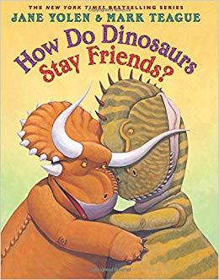
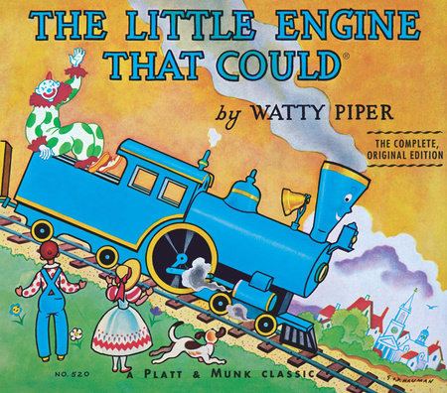
Tips for Building a set of Anchor Texts
Know your curriculum, subject matter.
Browse the library books that connect with their upcoming lessons.
How can the books in your library help you teach the content?
Make a list of books that cover or supplement reading strategies.
Anchor texts can be used in all grades—not just preschool and Kindergarten! Grade 5 and 6 students love read alouds too!
Notes:
Here are a few tips for building a set of anchor texts.
Know your curriculum, subject matter.
Browse the library books that connect with your upcoming lessons.
How can the books in your library help you teach the content?
Make a list of books that cover or supplement reading strategies.
Anchor texts can be used in all grades—not just preschool and Kindergarten! Grade 5 and 6 students love read alouds too!

Slide 7
Tips to a great Read-Aloud
Introduce the book to the group
Read with expression
Build in time for listeners to respond along the way
Encourage predictions
Watch your audience (eye contact)
Questioning to keep students on track
Point out parts of the story you noticed or especially liked
Encourage discussion about the story
Notes:
Here are a few tips to keep in mind when reading aloud!
Introduce the book to the group
Read with expression
Build in time for listeners to respond along the way
Encourage predictions
Watch your audience (eye contact)
Questioning to keep students on track
Point out parts of the story you noticed or especially liked
Encourage discussion about the story

Slide 8
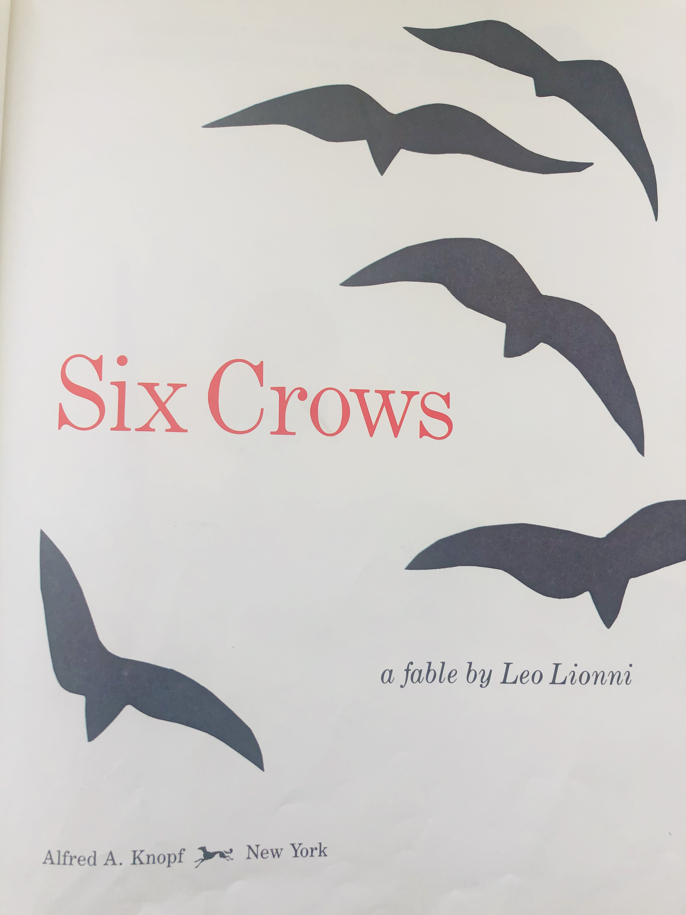
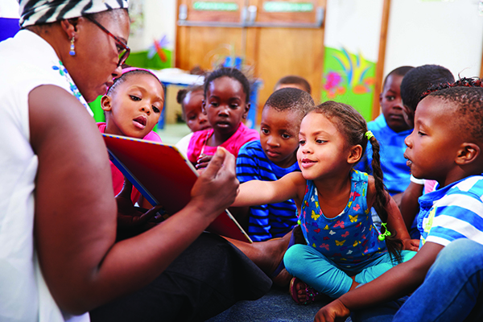
Read Aloud + Anchor Text Example
Notes:
So we are going to actually practice and model how to do an interactive read aloud and how to use an anchor text with the book Six Crows by Leo Leoni. This is a book Hands Across the Sea has sent to many school libraries that can be used to teach a number of curriculum content. I will share suggestions for younger grades as well as older grades. Take the ideas or questions that work best for you!
*What I will model with this book can be easily applied to other books that you have in your school library! If your school does not have this book yet, please add it to your library wishlist and share with our Literacy Link when they visit, so we can add it to your book collection!
*Six Crows a fable by Leo Lionni.

Slide 9

What is an interactive read-aloud?
Utilize prior knowledge
  Have you ever seen a crow?
  What do you already know about crows?
Notes:
An interactive read-aloud is interactive. You want to make the read-aloud like a conversation between you, the book, and the students. Engaging the students right from the beginning is key. One way to do that is by utilizing their prior knowledge. For this book, we could ask—
Have you ever seen a crow?
What do you already know about crows?
*And allow 2 or 3 students to give you a quick response. They don’t have to stand to respond, this can be while the child is seated around your feet or at their desk. But it is important to involve them, because we want their brains thinking while they are listening.

Slide 10
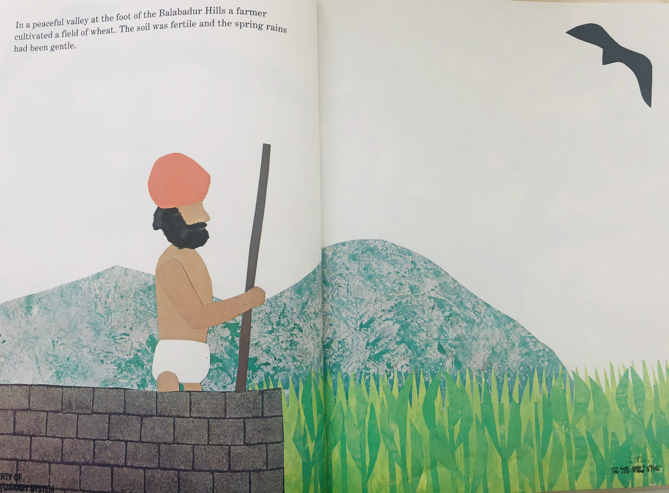
fertile
Notes:
In a peaceful valley at the foot of the Balabadur Hills a farmer cultivated a field of wheat. The soil was fertile and the spring rains had been gentle.
*What does fertile mean?
The soil was *fertile. Get your students to share their guesses and then affirm to them that fertile means farmable and ready for growing.

Slide 11
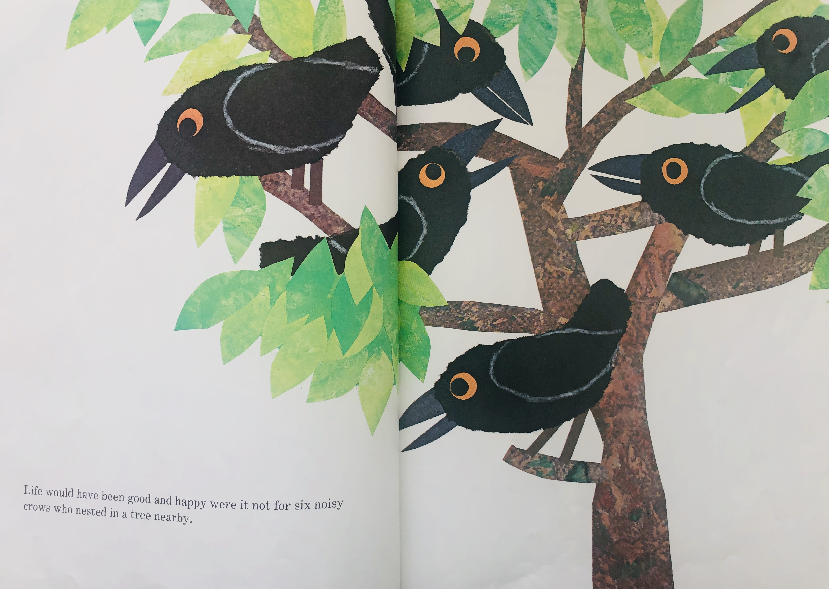
3 + 3 = ___
Notes:
Life would have been good and happy were it not for six noisy crows who nested in a tree nearby.
Let’s count the crows in the picture together. *1, *2, *3, *4, *5, *6. I see a *group of three crows on this side of the tree and a *group of three crows on the other side of the tree. *We know that 3 + 3 is what?
Easily turning this into a Grade K or Grade 1 math lesson on counting or addition.

Slide 12
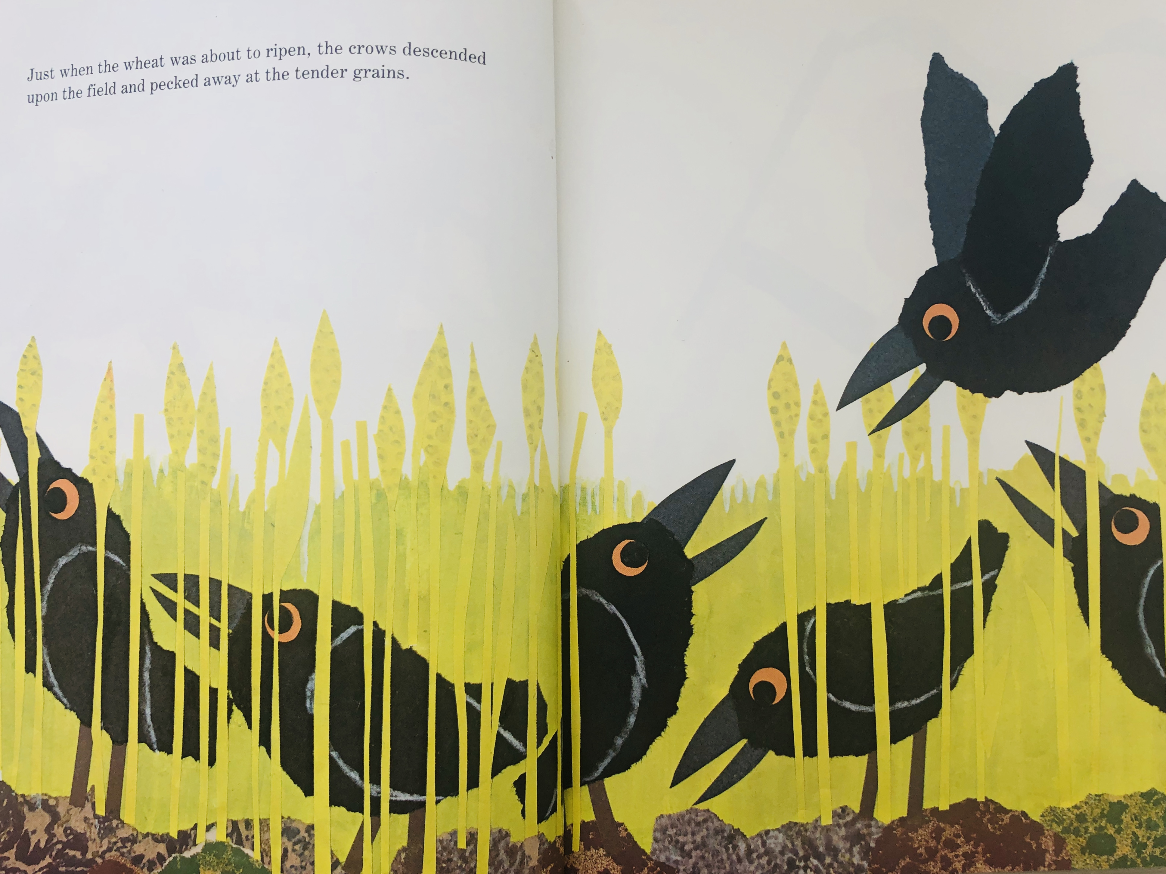
Notes:
Just when the wheat was about to ripen, the crows descended upon the field and pecked away at the tender grains.
Students can use context clues to determine what the word descended means based on what the crows are doing in the picture. They are coming from the sky and landing in the field.

Slide 13
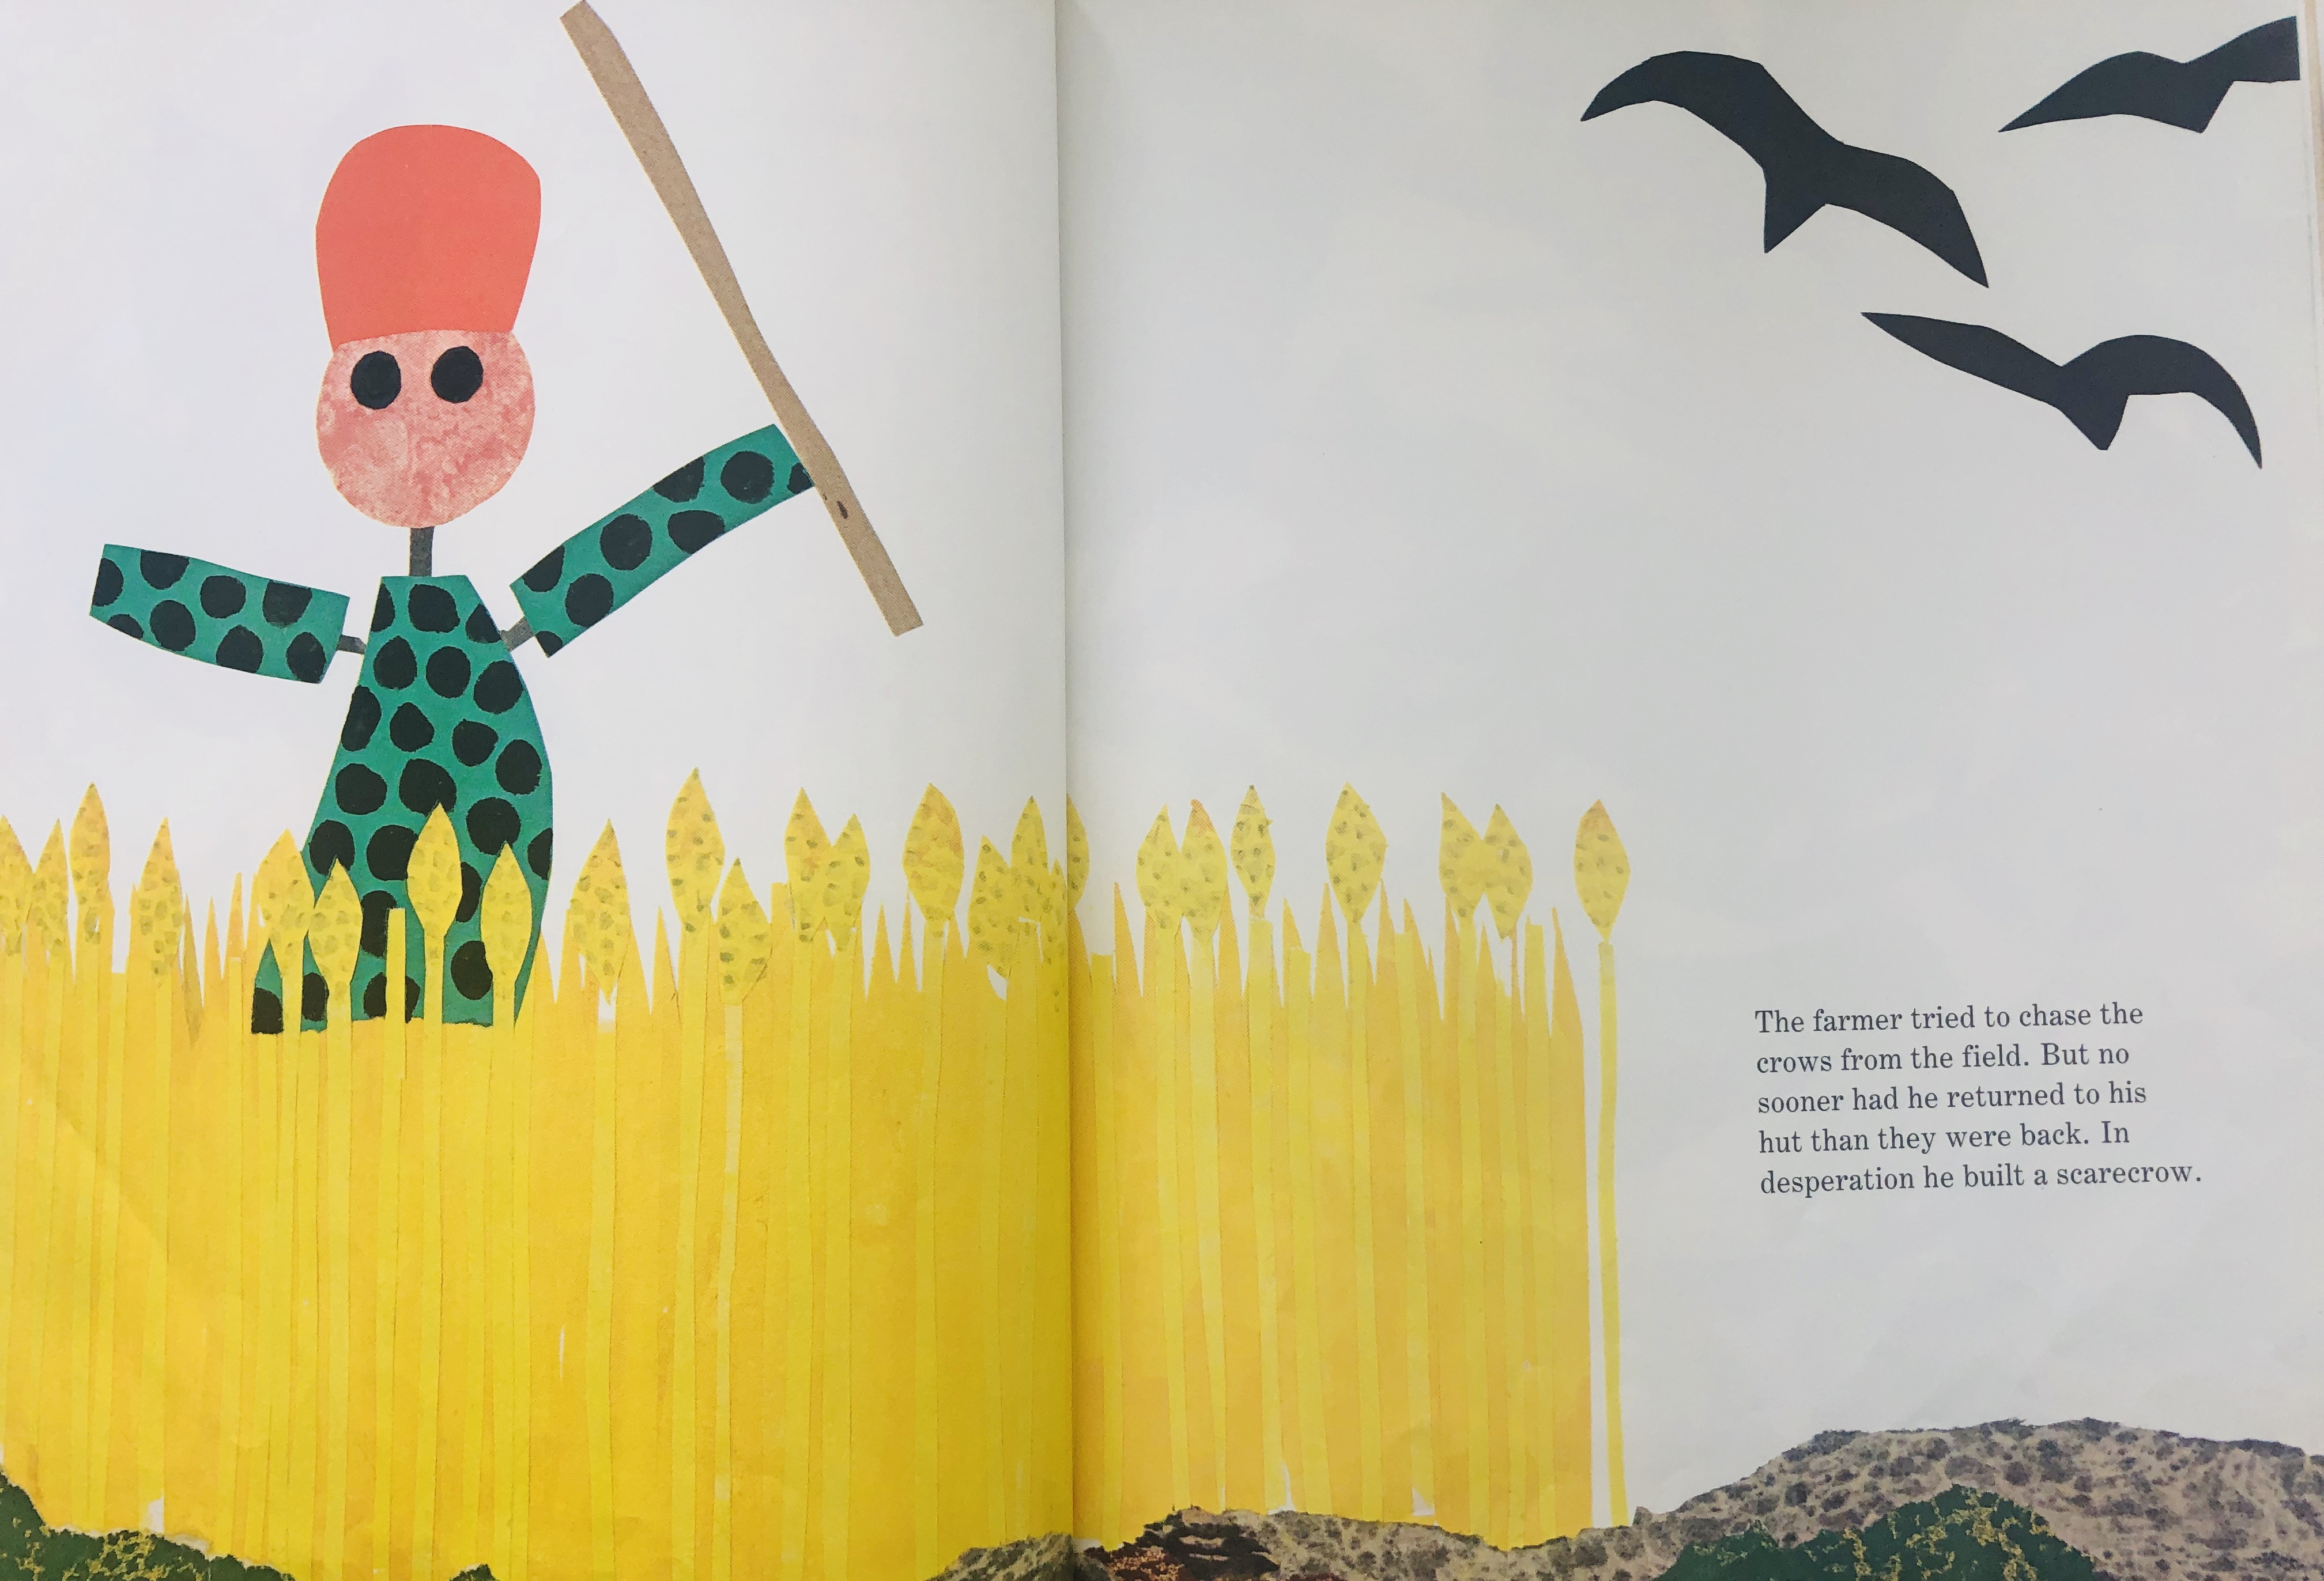
Notes:
The farmer tried to chase the crows from the field. But no sooner had he returned to his hut than they were back. In desperation, he built a scarecrow.
Why do you think the farmer wants to keep the crows out of his field?

Slide 14
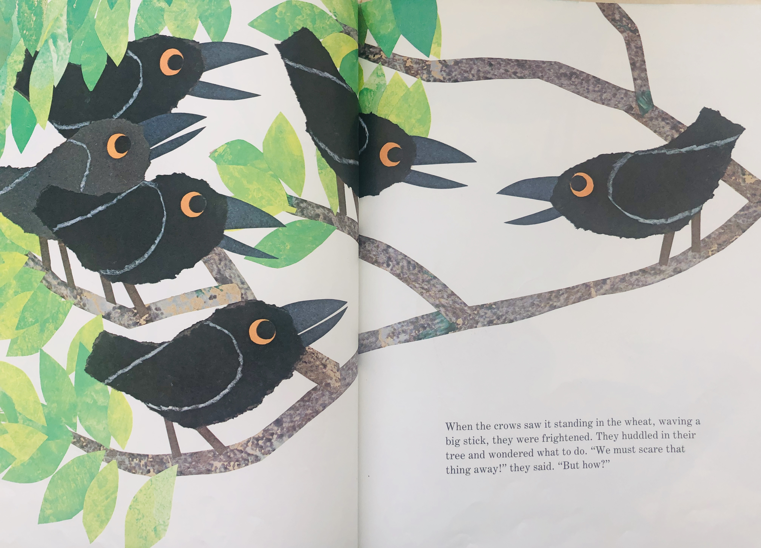
Notes:
When the crows saw it standing in the wheat, waving a big stick, they were frightened. They huddled in their ____*wait for the students to fill in the word “tree.” If they are silent, *point to the picture and use your facial expression to prompt them in responding.
The crows wondered what to do. “We must scare that thing away!” They said. “But how?”
What do you think the crows will do?
What do the crows not know about the scarecrow?
Will the scarecrow actually get scared away?

Slide 15
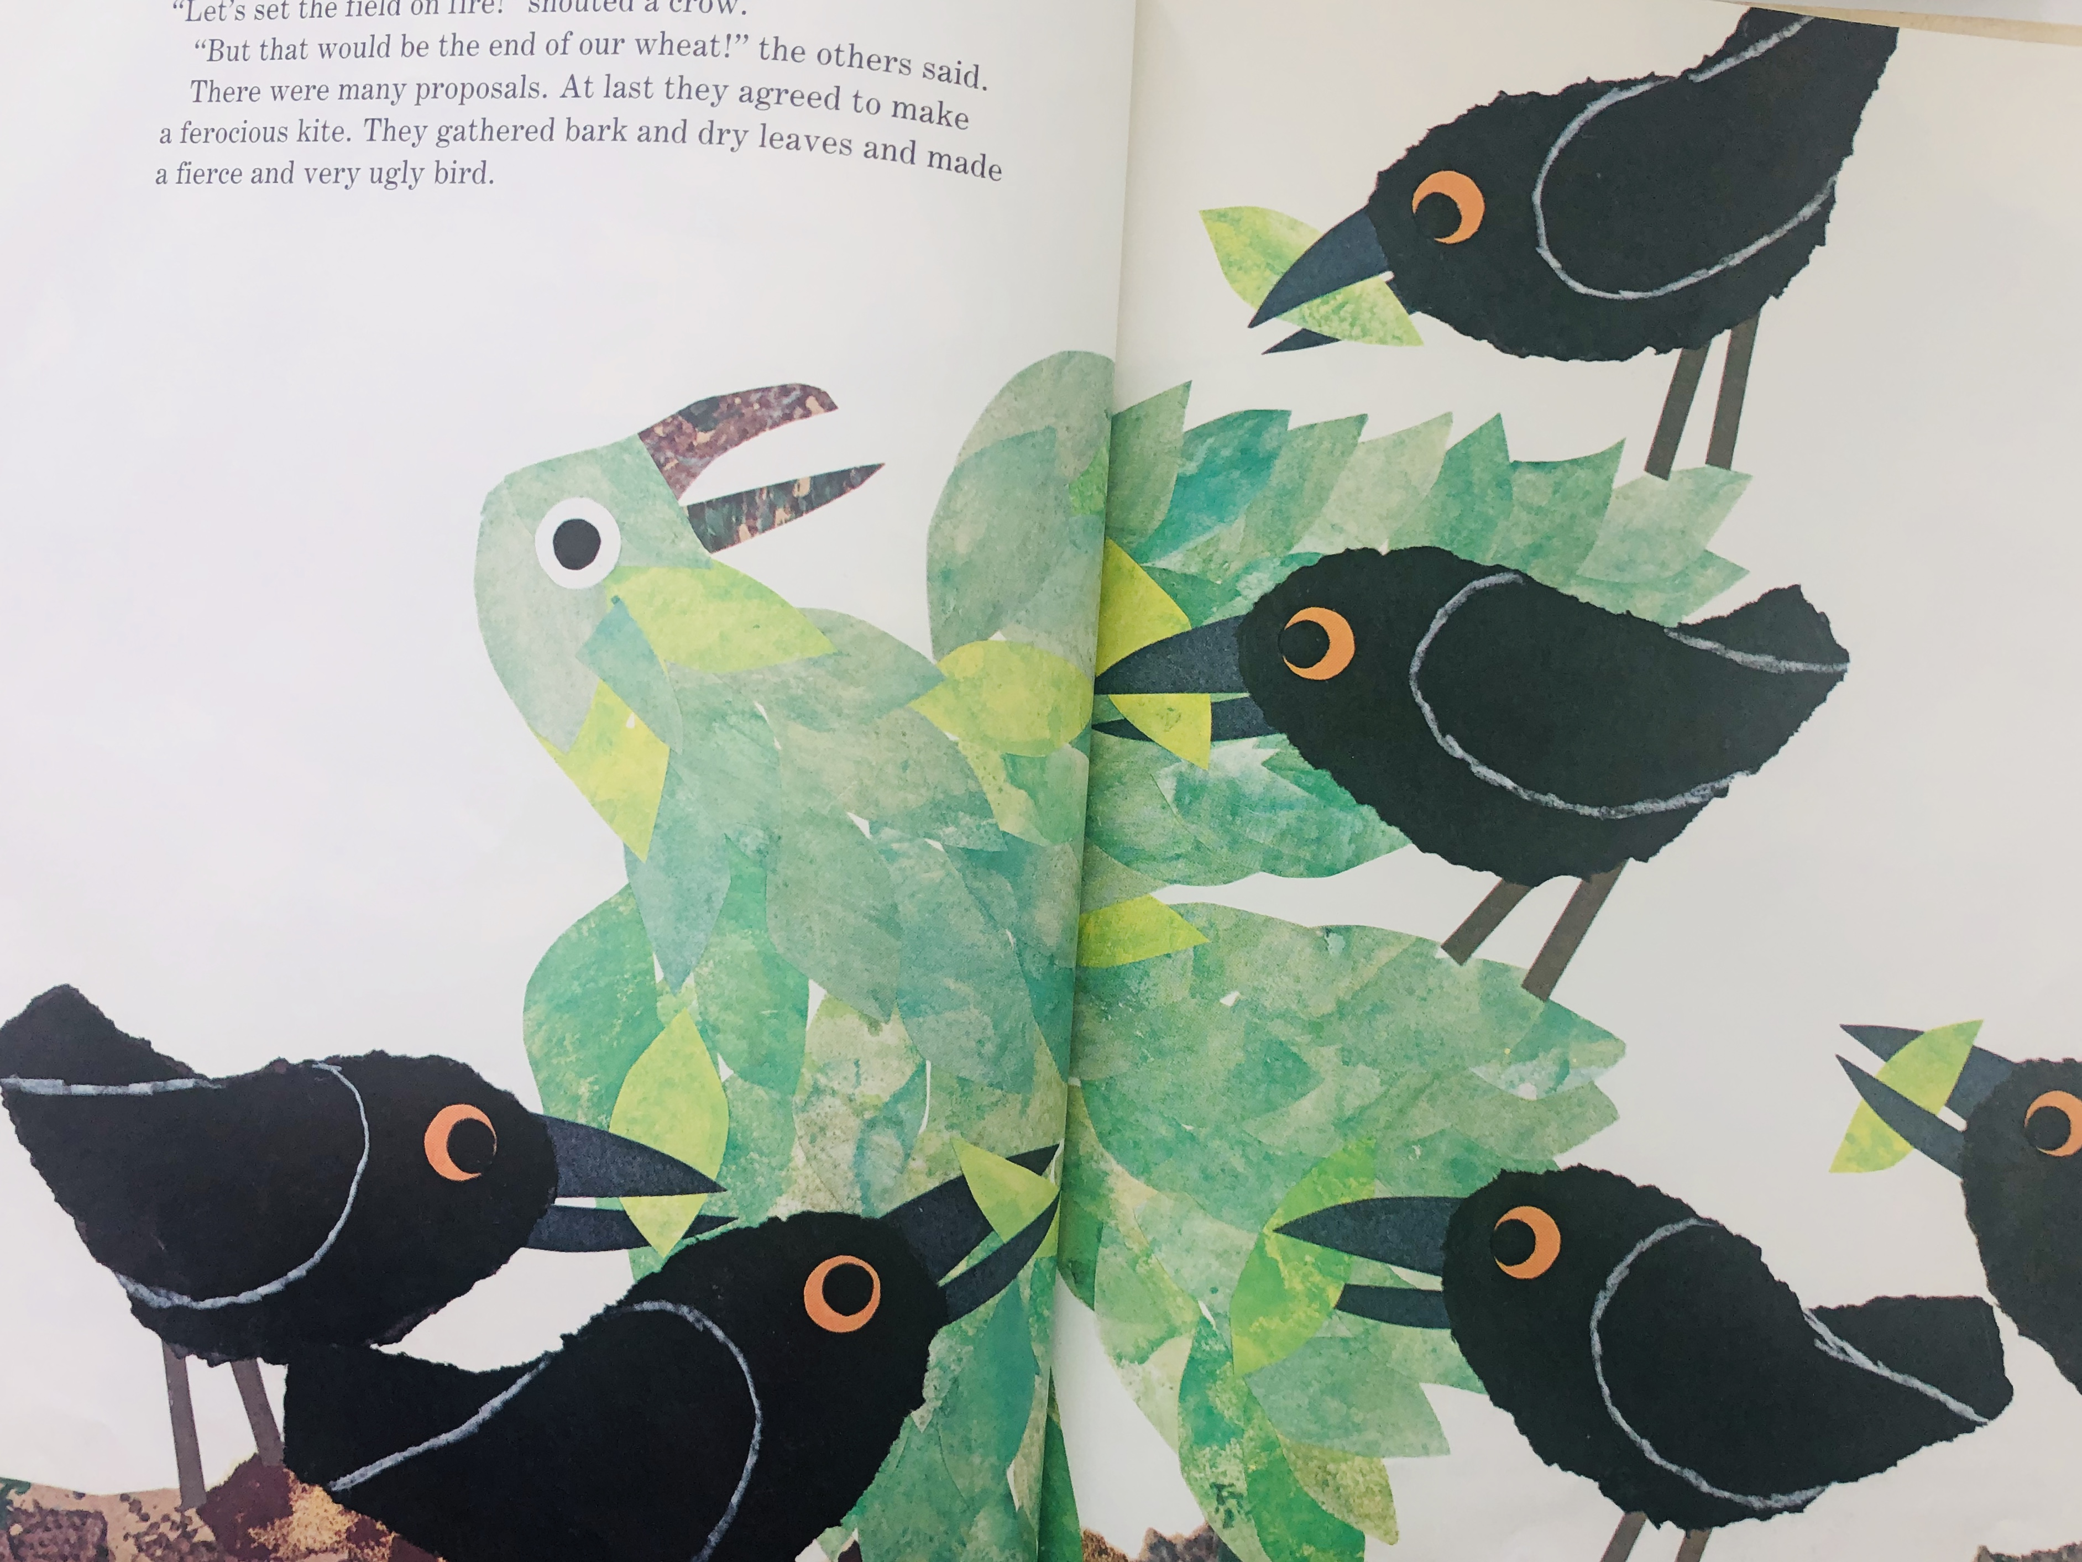
Notes:
“Let’s set the field on fire!” shouted a crow.
“But that would be the end of our wheat!” the others said.
There were many proposals. At last they agreed to make a ferocious kite. They gathered bark and dry leaves and made a fierce and very ugly bird.
You could use this page as an opportunity to discuss the meanings of two vocabulary words that are unfamiliar here—proposals and ferocious. When students learn unfamiliar words within the context of a story or a picture, they are that much more likely to start using these new words themselves.

Slide 16
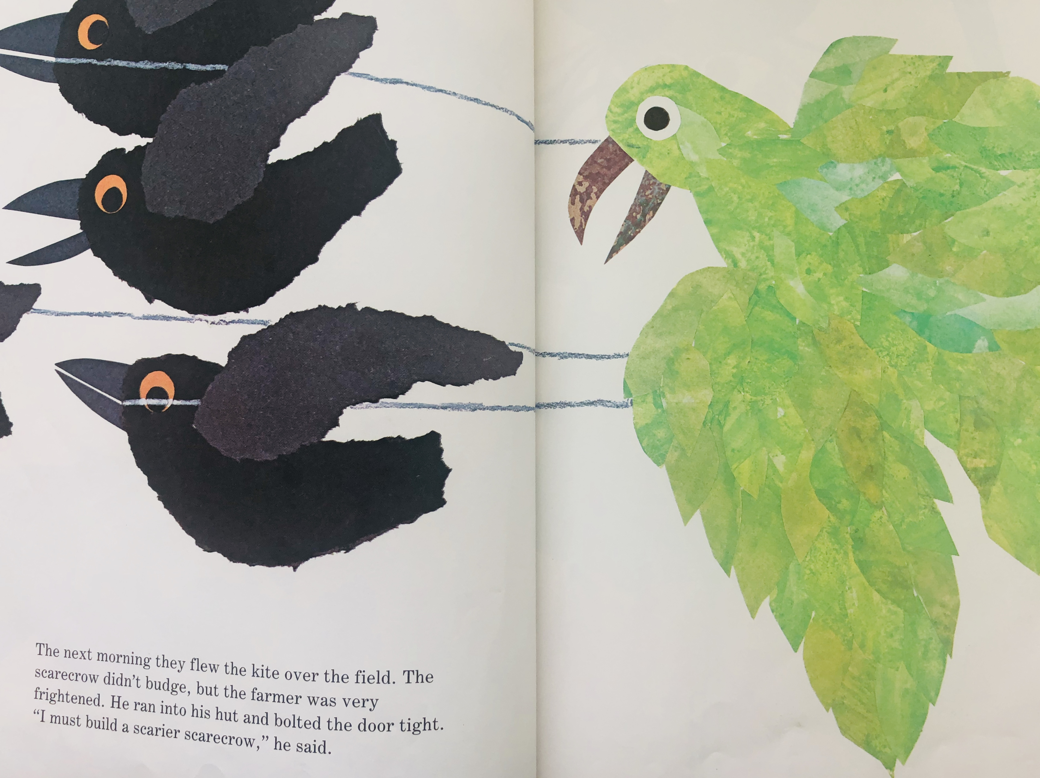
Notes:
The next morning they flew the kite over the field. The scarecrow didn’t budge, but the farmer was very frightened. He ran into his hut and bolted the door tight.
“I must build a scarier scarecrow,” he said.

Slide 17
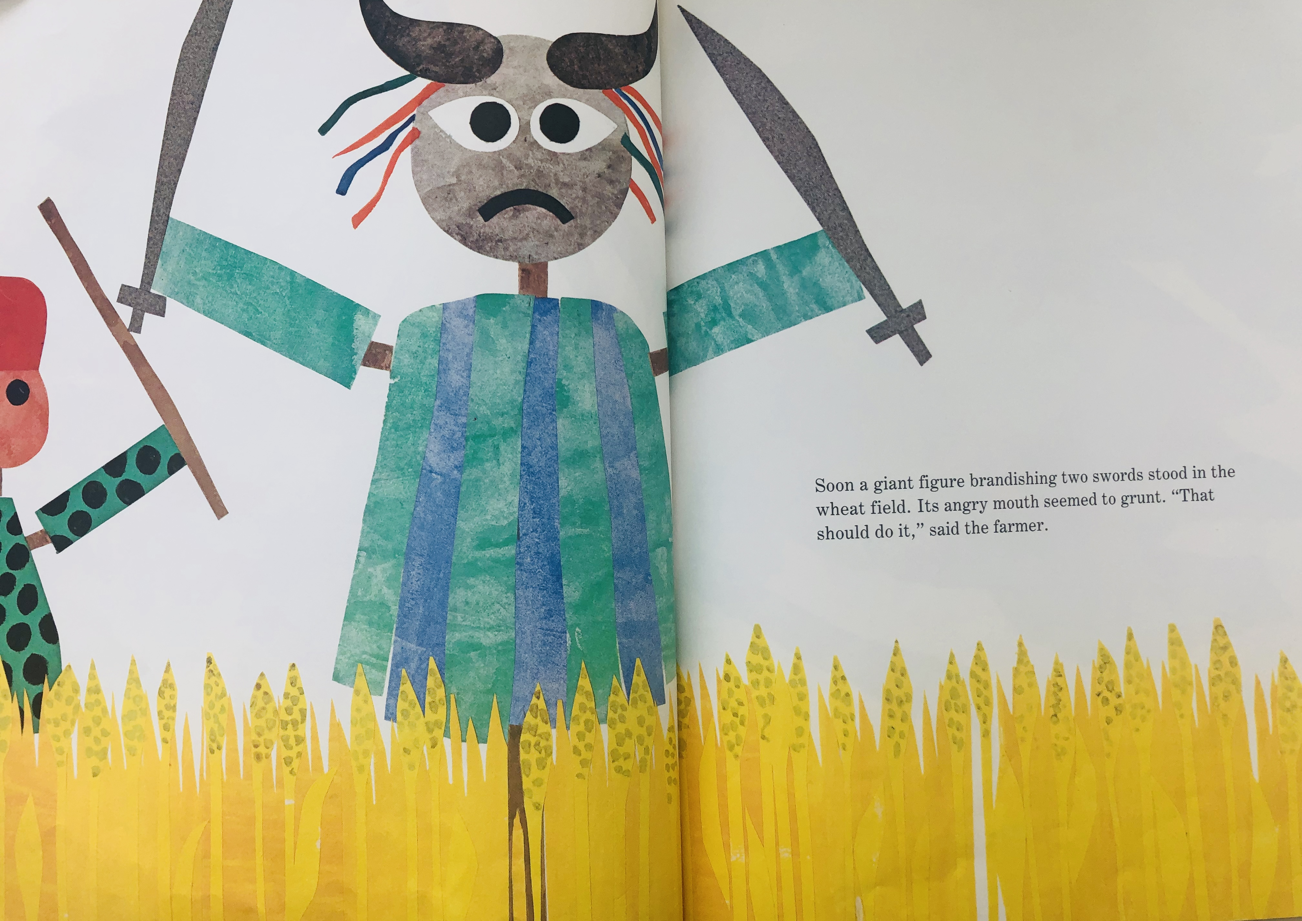
Notes:
Soon a giant figure brandishing two _____*you can actually point to the word on the page and wait for the students to fill it in. Or you can point to the picture and ask what the scarier scarecrow is holding in his hands.
Brandishing two swords stood in the wheat field. Its angry mouth seemed to grunt. “That should do it,” said the farmer.
Ask the students: How do you think the crows will respond to the scarier scarecrow? Give students wait time and then ask them to verbally share their ideas. This is inferencing and predicting. Both essential reading and thinking skills we want to encourage our students to do.

Slide 18
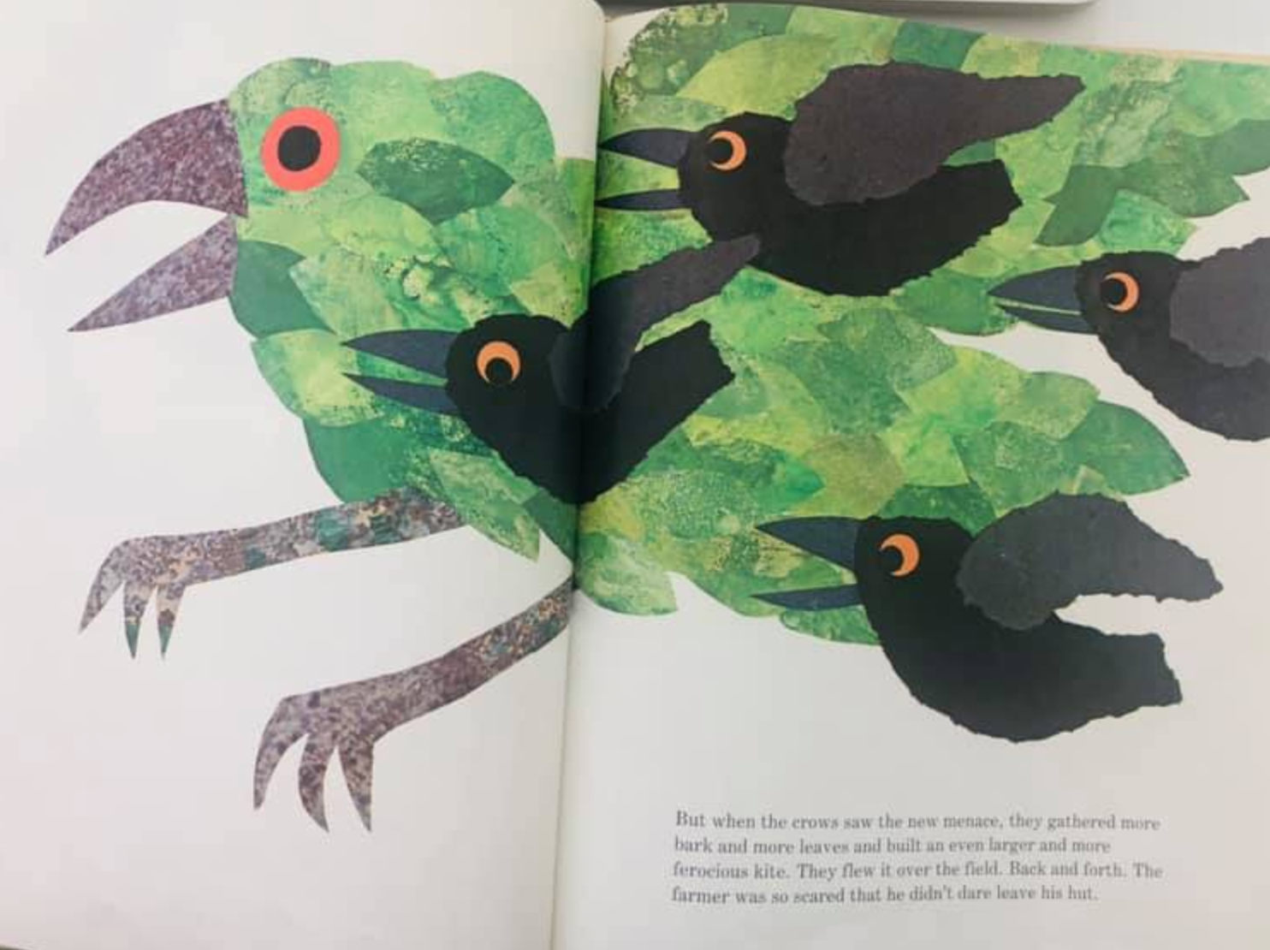
Notes:
But when the crows saw the new menace, they gathered more bark and more leaves and built an even larger and more ferocious kite. They flew it over the filed. Back and forth. The farmer was so scared that he didn’t dare leave his hut.

Slide 19
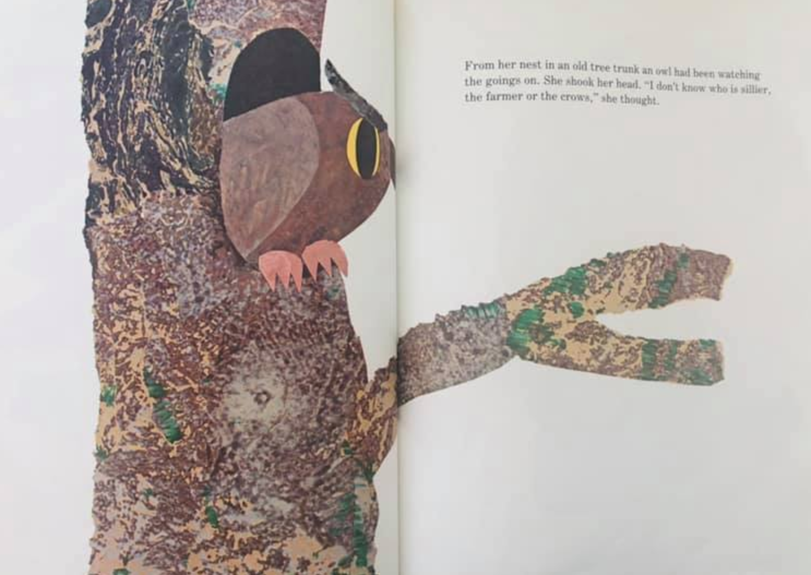
Notes:
From her nest in an old tree trunk, an ____ *again, wait for the students to call out with the word “owl” before continuing. This is the beginnings of shared reading. It also brings the students attention to the words on the page and instills in them a purpose for active listening.
“an owl had been watching the goings on. She shook her head. “I don’t know who is sillier, the farmer or the crows,” she thought.
Why does the crow think that the farmer and the crows are acting silly?

Slide 20
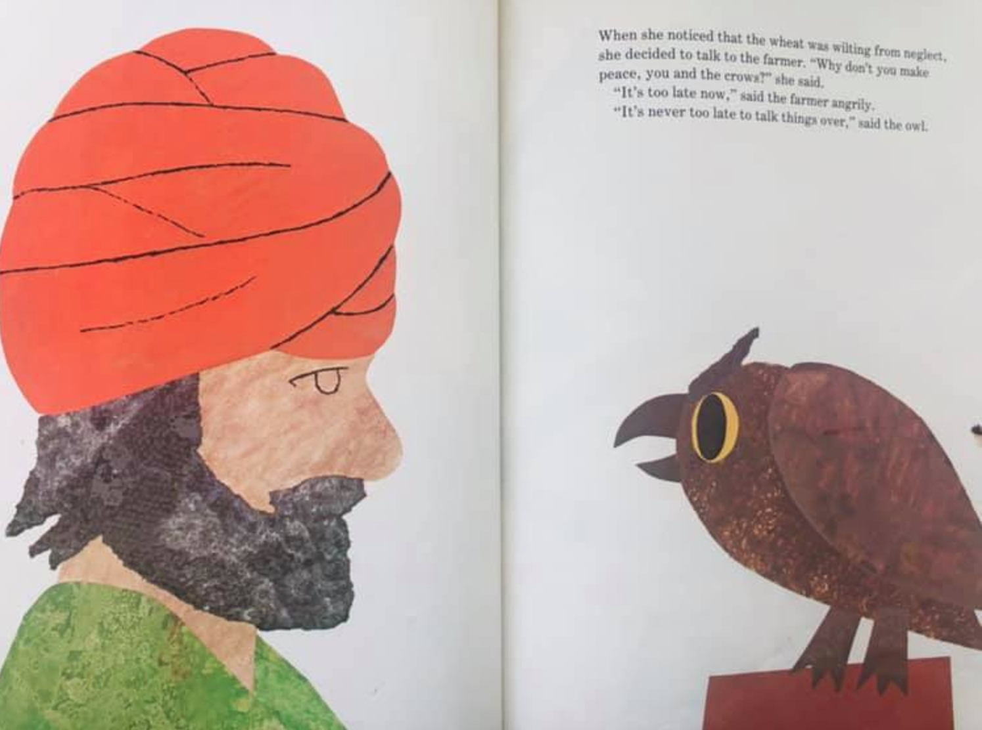
Notes:
When she noticed that the wheat was wilting from neglect, she decided to talk to the farmer.
“Why don’t you make peace, you and the crows?” she said.
“It’s too late now,” said the farmer angrily.
“It’s never too late to talk things over,” said the owl.

Slide 21
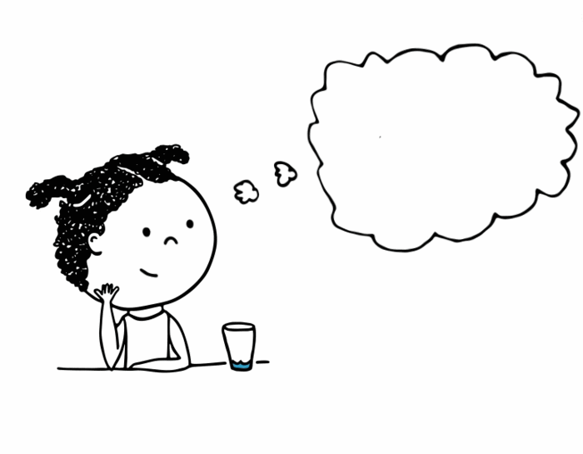
What is an interactive read-aloud?
Discuss while reading.
Ask/answer questions
  At the point in the story where the owl confronts the farmer, stop reading and ask the students what they would do to help the farmer and crows make peace.
Notes:
At the point in the story where the owl confronts the farmer, stop reading and ask the students *what they would do to help the farmer and crows make peace.
*You can do a think pair share here, where students think by themselves for a few seconds, then tell the student sitting next to them what they would do, and then share a response or two with the whole class.

Slide 22
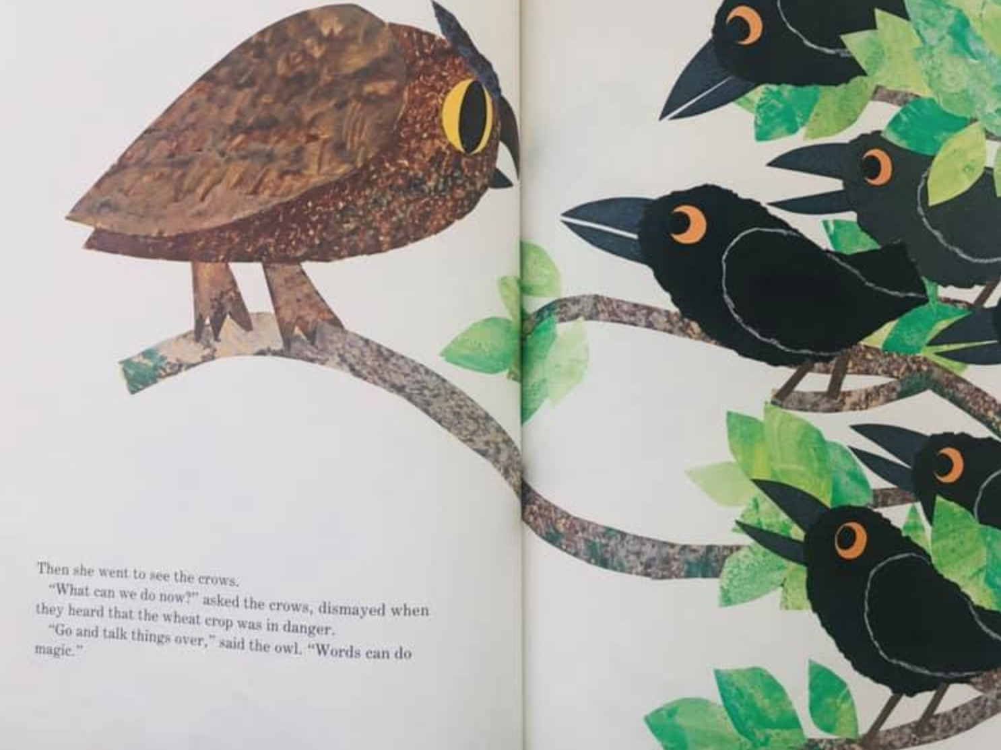
Notes:
*Then she went to see the crows.
“What can we do now?” asked the crows, dismayed when they heard that the wheat crop was in danger.
“Go and talk things over,” said the owl. “Words can do magic.”

Slide 23
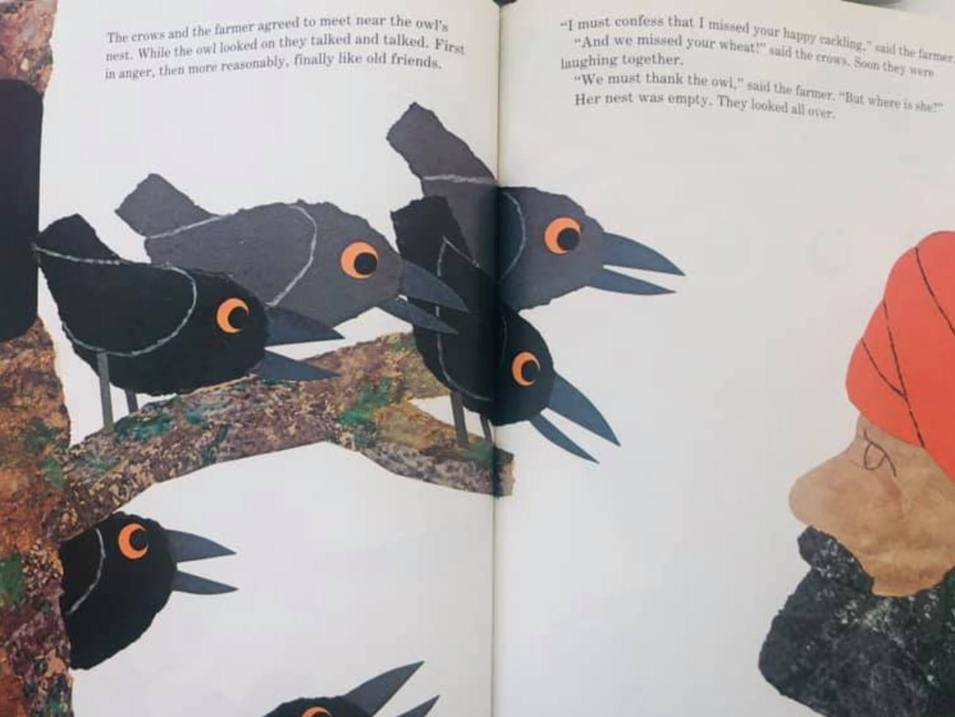
Notes:
*The crows and the ____* wait for the students to respond with the word farmer and *point to the farmer in the picture to prompt them.
The crows and the farmer agreed to meet near the owl’s nest. While the owl looked on they talked and talked. First in anger, then more reasonably, finally like old friends.
“I must confess that I missed your happy cackling,” said the farmer.
“And we missed your wheat!” said the ____* wait for the students to call out crows.
Soon the farmer and crows were laughing together.
“We must thank the owl,” said the farmer. “But where is she?”
Her nest was empty. They looked all over.

Slide 24
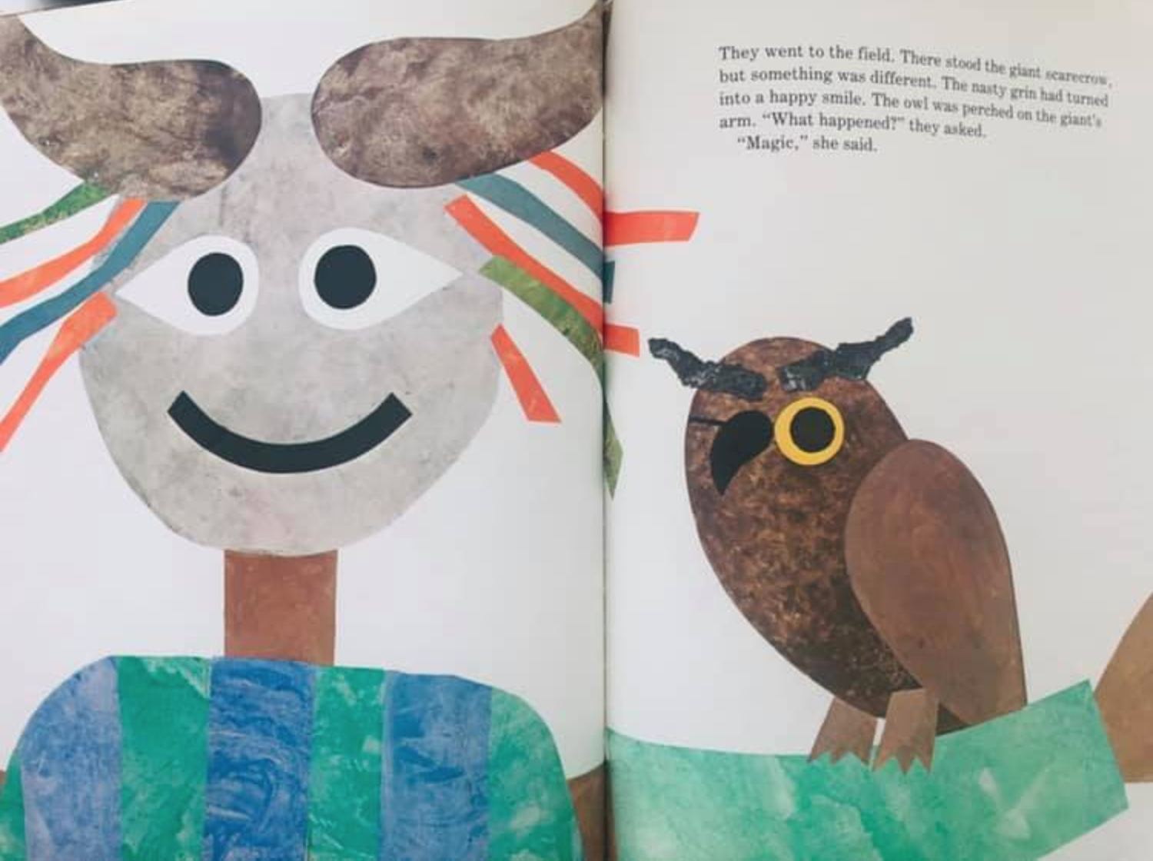
Notes:
*They went to the field. There stood the giant scarecrow, but something was different. The nasty grin had turned into a happy ____* smile. The owl was perched on the giant’s arm.
“What happened?” they asked.
“Magic,” she responded.

Slide 25
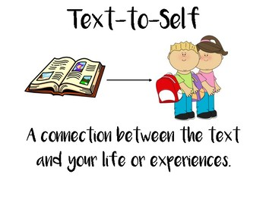

What is an interactive read-aloud?
Make up questions as you go based on what you know is coming up in the story.
Make connections
  Have you ever fussed and fought with each other (brother, sister, friend) to get back at one another?
Analyze/Evaluate: Think critically and offer opinions
  What do you think the farmer should do about the situation?
Notes:
*So as you can see from the model, you as the teacher can make up questions as you go based on what you know is coming up in the story. You don’t have to have pre-planned questions.
*Prompt the students to make connections to the book. You could ask: Have you ever fussed and fought with each other (brother, sister, friend) to get back at one another?
*Analyzing and evaluating are higher level thinking skills that we can encourage our students to start considering. Thinking critically and *offering opinions is one way to do this. You could ask: What do you think the farmer should do about the situation?

Slide 26
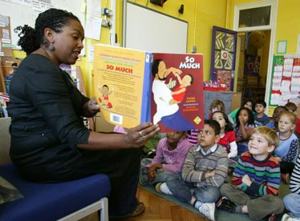
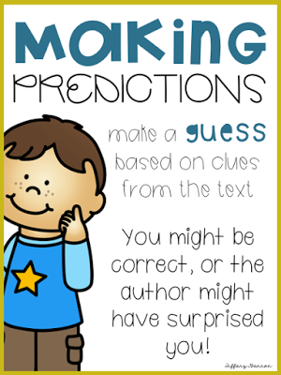
What is an interactive read-aloud?
There is no “wrong way” to do a “read aloud,” so experiment and figure out what works and what does not with you and your students for next time.
Infer
  What can we assume about the farmer when he sees the crows?
Predict
  What do think the crows are going to do because of the scarecrow?
Notes:
*I want to encourage you that there is no “wrong way” to do a read aloud, *so experiment and figure out what works and what does not with you and your students for next time.
Inferring means using the picture and the clues in the story to determine things that aren’t outrightly stated in the text. *For example, what can we assume about the farmer when he sees the crows? We can assume his is mad. The text doesn’t directly tell us that, but we can tell from the picture and from his response to the crows, that he is angry.
*Predicting means guessing what will happen next in the story. Asking the students what they think the crows are going to do because of the scarecrow is a great question to engage them in thinking while they are listening. Then they will find out on the next few pages whether their predictions were correct. Keep in mind that it is ok if a student predicts incorrectly. Keep encouraging your students to make educated guesses while reading, because it will keep their minds actively engaged in the reading and listening process.

Slide 27
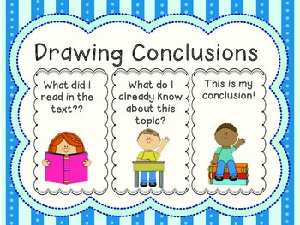
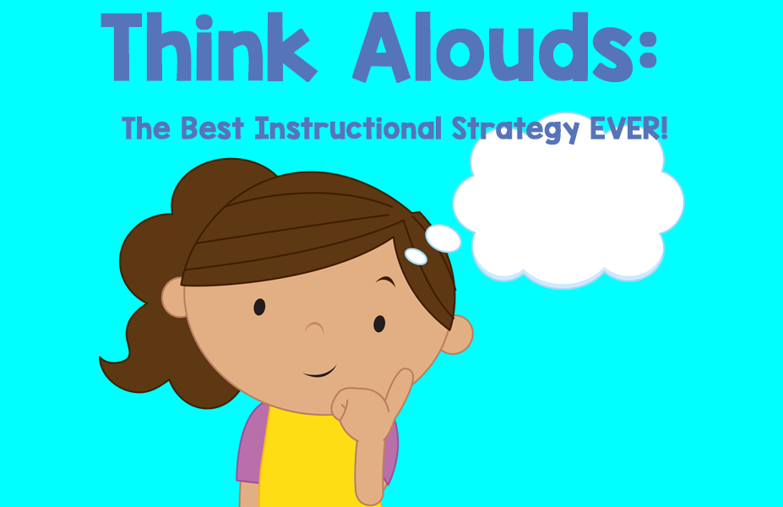
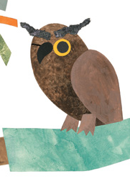
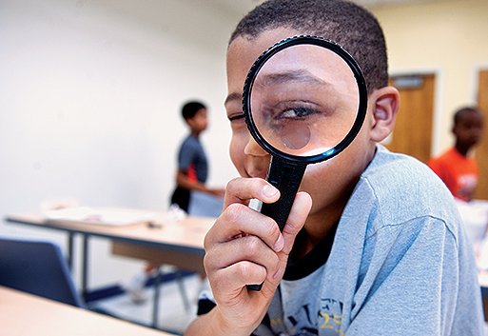
What is an interactive read-aloud?
Stop and make observations about what is happening in the story by sharing what you think. This is called “thinking aloud.”
Point of View
  From the crows’ point of view, they decide they must scare the scarecrow away so they can eat the grain.
Drawing Conclusions
  What do the crows want?
  What does the farmer want?
  What does the owl suggest?
  The owl observes that the wheat is going to spoil if the crows and farmer continue fighting so he becomes a negotiator and talks to both sides who come to a compromise.
Notes:
*During the read aloud, stop and make observations about what is happening in the story by sharing what you think. *This is called “thinking aloud.” It is so important for your students to watch you model how your brain thinks while you read, because they will pick up those skills and realize that’s what they too are supposed to do while THEY read!
*Point of View is another comprehension concept that can sometimes be difficult for a student to learn. Talk to your students about the three different points of views in the story—the *crows’, *the farmer’s, and *the owl’s. From the crows’ point of view, they decide they must scare the scarecrow away so they can eat the grain.
What was the farmer’s point of view?
What was the owl’s point of view?
Which of the three points of views do you agree with? Why?
*Drawing Conclusions is another higher level thinking skill we want our students to learn and feel comfortable with. These questions ask students to draw conclusions:
What do the crows want?
What does the farmer want?
What does the owl suggest?
The owl observes that the wheat is going to spoil if the crows and farmer continue fighting so he becomes a negotiator and talks to both sides who come to a compromise.

Slide 28
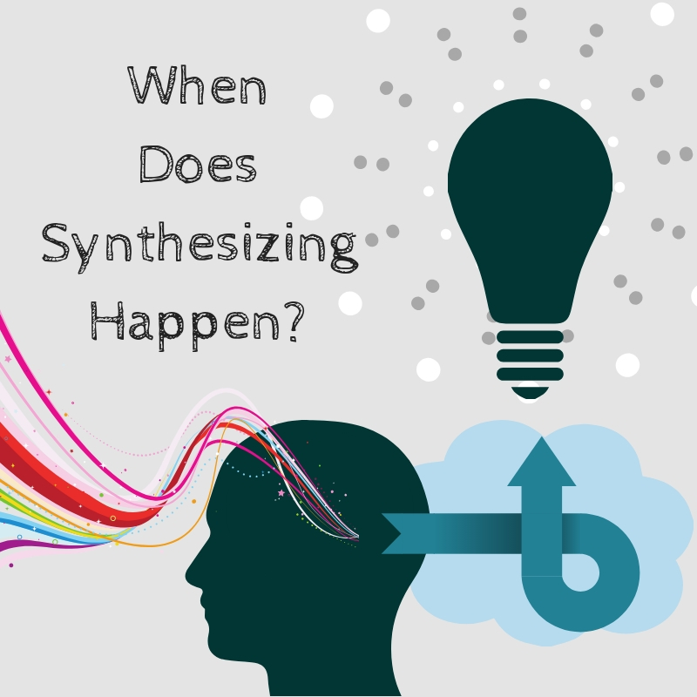
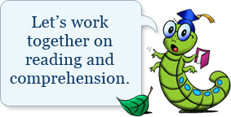
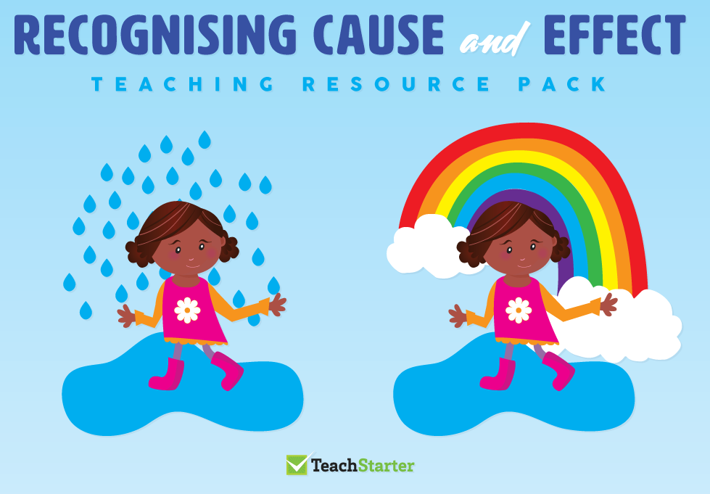
Shared Reading
You can do a “shared reading” of this book and ask questions along the way at the same time.
Cause and Effect
  What does the farmer build to make the crows stop eating the wheat seeds? (effect)
  What makes the farmer build an even scarier scarecrow? (cause)
Synthesis
  What does “words can do magic mean”?
  Talking things out is better than letting what we are fighting over spoil.
Notes:
*This book lends itself to shared reading as I modeled. Stop before a sentence ends and ask the students to finish it by reading aloud together. Students will be able to infer what word or phrases come next. And keep in mind that you can read the book aloud a second time to the students the next day—and they will know even more of the words and phrases from the book and can be even more involved in the shared reading of the book the second time around!
*The more familiar with a book, the more willing students are to participate in shared reading. *You can also use cause and effect questions to prompt students to write responses, especially in higher grade levels.
What does the farmer build to make the crows stop eating the wheat seeds? (effect)
What makes the farmer build an even scarier scarecrow? (cause)
*Synthesizing is another reading skill that requires practice. The question: What does “words can do magic mean”? Is a prompt that can generate a class discussion synthesizing the meaning of the fable from the book but also about how…
Talking things out is better than letting what we are fighting over spoil. You as the teacher can guide the discussion to how we can apply the lesson from the story into our every day lives.

Slide 29

What are the benefits of an anchor text?
What made it interesting, engaging, enjoyable—a learning experience?
What other book titles can you think of that may make a good read aloud and anchor text?
Notes:
*So what would you say are the benefits of an anchor text?
Can you see how we can refer back to the read aloud Six Crows when teaching all of the reading comprehension skills we discussed? This can be done during one lesson or you can use this book as an anchor text for the whole week, several days, or during the course of a unit. You get to decide.
The key is that you use books and their context to teach these skills rather than teaching the skills in isolation. It is so much easier for students to understand how to actually do these skills with an actual book. And when they are confident in the story line, students are much more likely to go outside of their comfort zone to try to apply these reading comprehension skills.

Slide 30
What is one new thing you learned today that you are going to try with your students?
Anchor Texts and Interactive Read Alouds
1.
2.
3.
4.
1.
2.
3.
4.
Notes:
*Now let’s complete the KWL chart to *add on what we learned and what we want to take back to our classes from this example. We need at least 1 response from each person. **So write down on a sticky note what is one new thing you learned today that you are going to try with your students and let’s fill this last column up.

Slide 31
Discussion questions you can use with any book:
Favorite character? Why?
At what point in the story did you get hooked?
Favorite scene and why?
If you could change anything about the book, what would it be?
World Building - How did you like the world the author built?
What was the most annoying thing/person/situation?
What would you have liked to see from this book that was not put in?
Notes:
*Here are some discussion questions that you can use with any book, any read aloud, to get your students engaged in the thinking while listening or the thinking while reading process. Feel free to take a photo of these questions or jot down the ones that you can see yourself asking to your students.
Keep in mind that all of these questions can be easily turned into writing prompts for older students in Grades 3, 4, 5, and 6. A short paragraph in a Reader’s Notebook may be just what you need to tack on the writing piece to make your lesson complete.
Favorite character? Why?
At what point in the story did you get hooked?
Favorite scene and why?
If you could change anything about the book, what would it be?
World Building - How did you like the world the author built?
What was the most annoying thing/person/situation?
What would you have liked to see from this book that was not put in?

Slide 32
Discussion questions you can use with any book:
What book do you know of right now that you could do a read-aloud with?
Favorite character? Why?
At what point in the story did you get hooked?
Favorite scene and why?
If you could change anything about the book, what would it be?
World Building - How did you like the world the author built?
What was the most annoying thing/person/situation?
What would you have liked to see from this book that was not put in?
Notes:
Let’s wrap up with one final think, pair, share activity. Answer this question by yourself first, then with a partner, and finally with the whole class:
What book do you know of right now that you could do an interactive read-aloud with and use as an anchor text?

